Slide 1
Funding Success
Data to results

Slide 2
Funding prediction
Preprocessing-Used PCA to reduce 19000 features down to 200 features. Smote the 200 features to balance out data.
Model Development-Answered yes or no on weather project was successful. Three layers of 300,30,10 and one output layer.
Results-0.78 against the test data and a 0.44 loss.

Slide 3
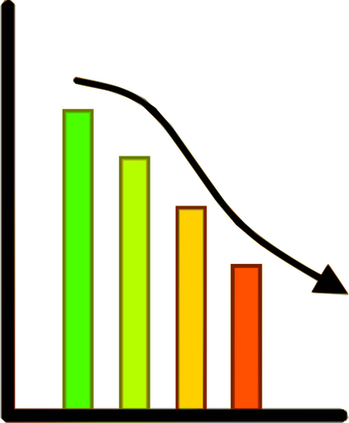
Preprocessing
-One hot encoding
-Smote
-Colab PRO
-PCA
Wrangling data

Slide 4
Preprocessing
The is_sucessful column was used as the target that we want to predict
All features were used and condensed with PCA
Some rare categories and application types were converted to an other category. Leaving these in with PCA should be reviewed further

Slide 5
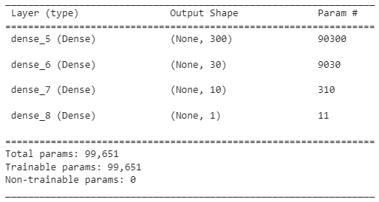
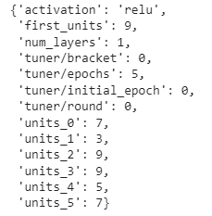
Compiling and Training
Actual Model
Recommended Model

Slide 6
Results
The initial and optimized model have an accuracy of .78-.79%.
If the model is used in production a 20-25% loss could be factored into the pricing risk to account for model error
Next steps would be to try better data reduction techniques.
A different model with yes or no predictions by category would help dial in the prediction because they are skewing the data.

